Slide 1
NLP -Section 9
Self-Attention + Transformers

Slide 2
Self-Attention
Same idea as attention but instead of reflecting the attention on the output, it reflects on itself.
Creates context embeddings
Lacks positionality

Slide 3
Self Attention - Matrices
We create Q, K, V for each token.
Q (query): A learned projection of the input embedding used to compute attention scores toward all other tokens.
K (key): A learned projection that interacts with queries so that the model can decide how much attention a token should receive.
V (value): A learned projection that carries the content to be aggregated based on the attention weights.
Q, K, and V have # of columns equal to the number of tokens each column representing a token (by small letter and index ex: q1, v3).
Calculated through Wq*X, Wk*X, Wv*X

Slide 4
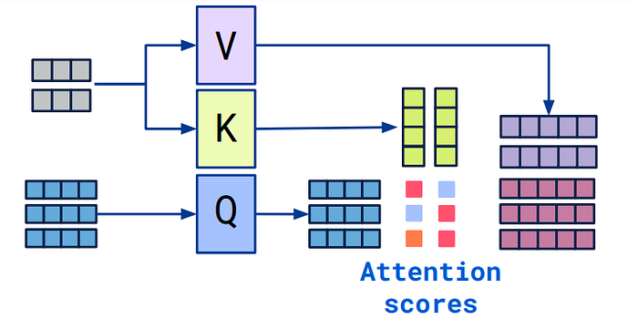
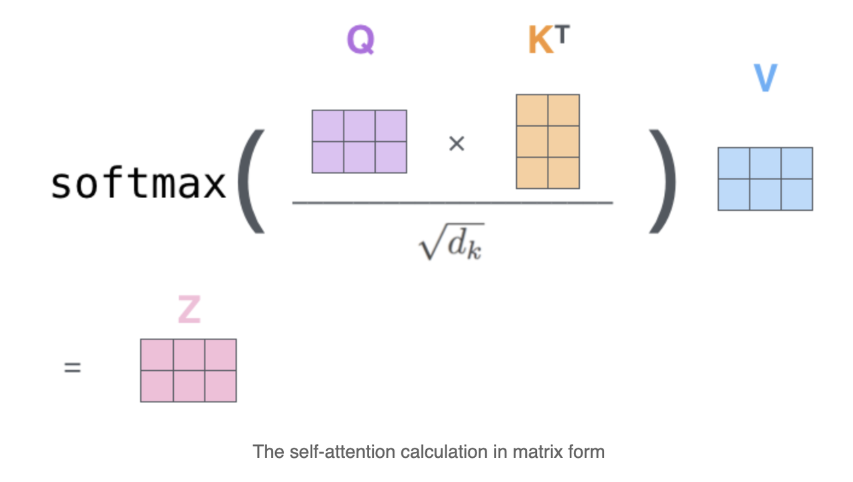
Self-Attention - Calculation
The most straightforward method:
Calculate the score by q.k (the dot product) to get a single value
Weight the values around zero by dividing by root d then applying softmax
Multiply by v to get the output context representation z
output context embeddings

Slide 5
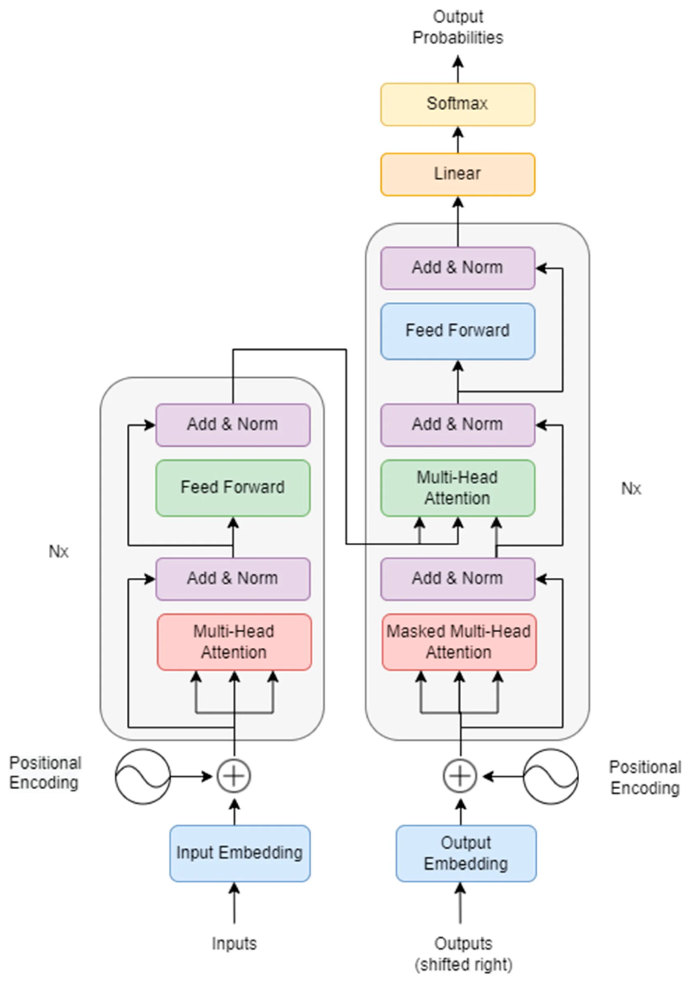
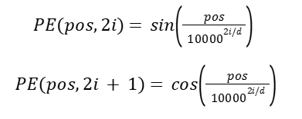
Transformers Architecture - Positional Encoding
Positional Encoding can be learned (new architectures) or sinusoidal (original transformer.
Sinusoidal where:
1. pos is the position
2. i is the embedding dimension
3. d is the dimension of the embedding dimension
sin calculates the even dimensions and cosine calculates the odd dimensions.

Slide 6
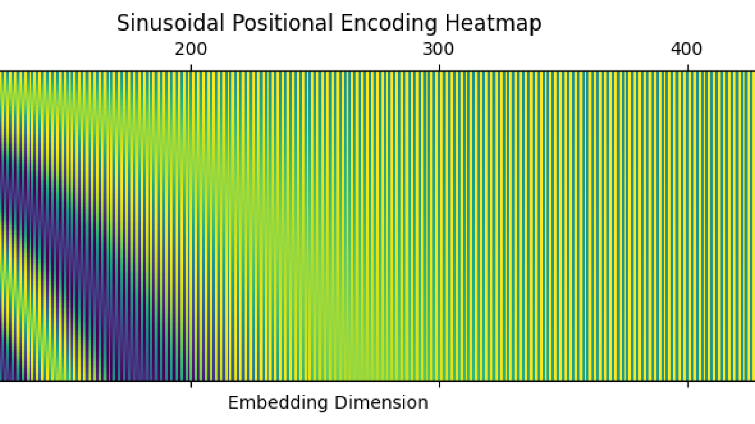

Slide 7
Transformers Architecture - Positional Encoding Cont.
Learned:
Each position gets a vector embedding.
This vector embedding is learned during training such as any other weighted matrix
pos 1 will have a constant embedding regardless of what is at the position.
This is simpler and makes the model not constrained to sinusoidal representation.

Slide 8
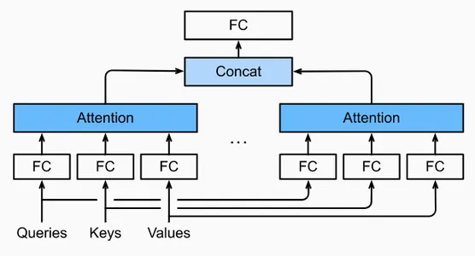
Transformers Architecture - Multihead Attention
Instead of relying on one attention head, calculate the attention multiple time and concatenate the results.
Return to the original dimension by processing through the feed forward layer.

Slide 9
Transformers Architecture - Layer Normalizaiton
x − μ(x)
______
σ(x)
Helps normalize the outputs of the multihead attention layer.

Slide 10
Transformers Architecture - Feed Forward NN
Feed forward NN introduces the regular NN linear layers with activation functions.
Preserves the original input shape

Slide 11
Transformers Architecture - Skip Connections
As in ResNets, add the output of the previous block to the next block.
This helps smooth the loss and make training easier.

Slide 12
Transformers Architecture - Encoder
The outputs z can be calculated in parallel which speeds inference using GPUs.
We can stack more than one encoder on top of each other to introduce complexity to the model and get better contextual embeddings.

Slide 13
Transformers Architecture - Masked MHA
Masked multi-head attention is the same as regular attention but “masks” the attention of the outputs.
“I love dogs.” as the output “I” shouldn’t know that “love” comes after.
Preserves the “auto regressive” trait.

Slide 14
Transformers Architecture - Cross Attention in MHA
K = encoder output × W_K (Key projection matrix)
V = encoder output × W_V (Value projection matrix)
Q = decoder hidden × W_Q
Then it’s normal self-attention. This step combines both the encoder and decoder outputs.
This can be stacked too, but K and V are constant from the same encoder output.

Slide 15
Transformers Architecture - FNN to Output
The output of MHA goes through a normal NN with linear layers and activation functions.
This NN and the linear layer that follows reshape the output based on the task.
The softmax function converts to probabilities in the one-hot encoding space to be able retrieve the sequence in each step.

Slide 16
Code
Self-Attention
Transformer from scratch

